Slide 1
Little Lemon Analysis
File created on: 7/27/2023 7:25:29 PM

Slide 2
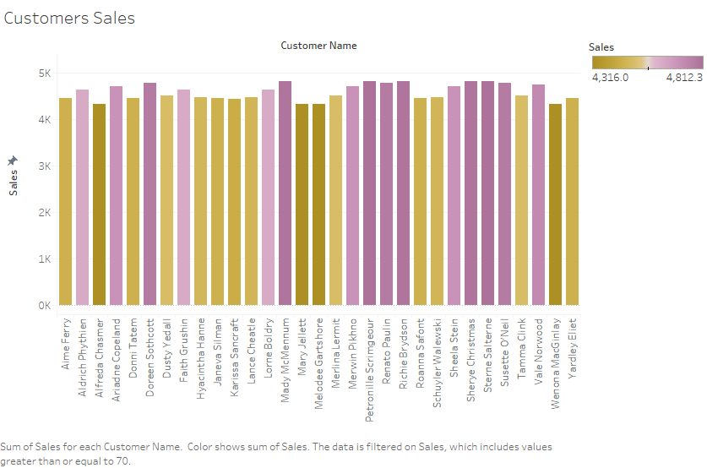

Slide 3
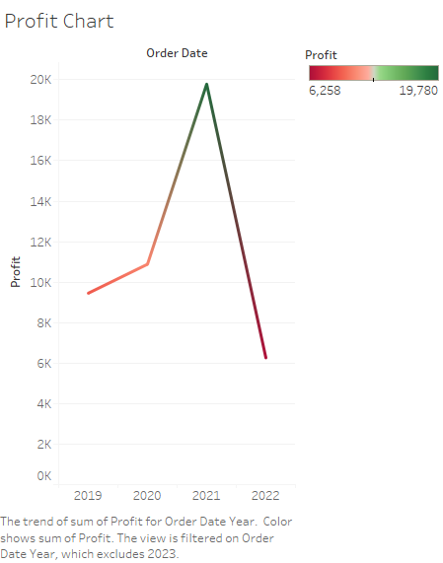

Slide 4
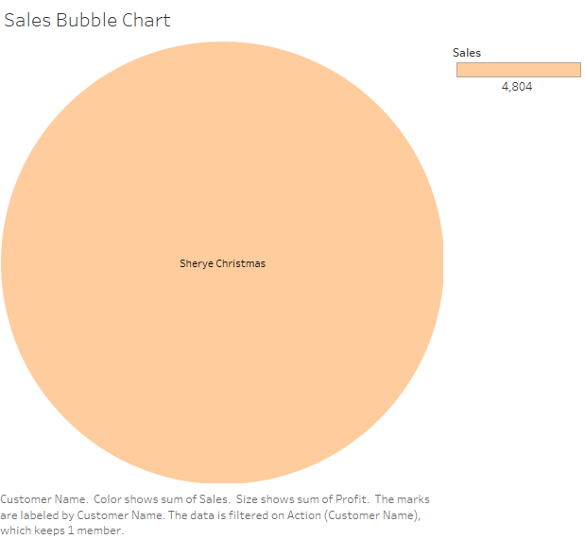

Slide 5
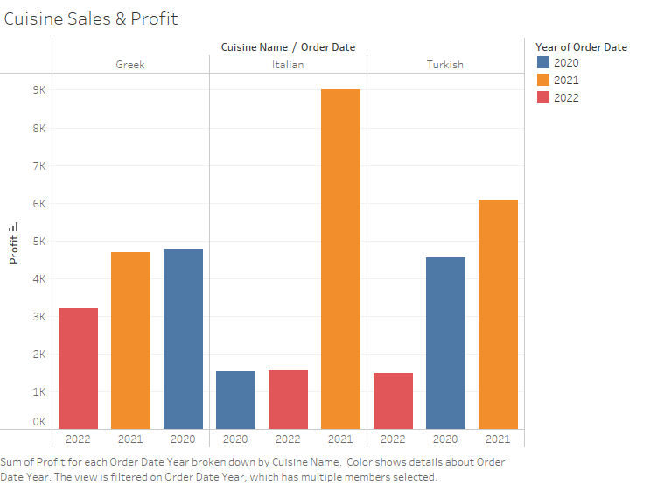

Slide 6
